Slide 1
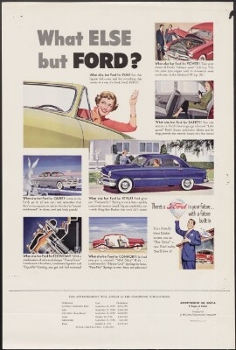
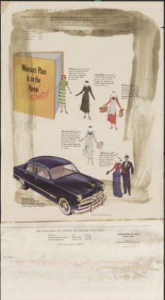
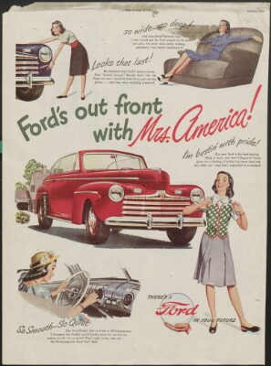
Woman’s Place is in the Ford: Gender, Culture, and the Economy in the Post-war United States
Key Learning Objectives:
Compare how women & men are portrayed in the different ads, as well as any changes in those portrayals between 1945 & 1950
evaluate gender roles in the immediate postwar period, as they were tied to and influenced by economic, social, & cultural forces
Guiding Questions
  What do these ads reveal about the postwar US?
  How were Ford cars marketed to women? To men?
  What does the way women are represented in these ads reveal about gender roles in the immediate postwar period?
Notes:
Ford Motor Co. Ads
For use in: Am. Women’s History after 1865, US History after 1865, US Business History, etc.
Preparation: Students should look at the assigned ads before participating in this lesson, along with the assignment sheet itself. Additionally, students should have already heard lectures on women’s ideal role in the early 20th century, along with changing expectations during WWII.
Students will have the opportunity to analyze each of the ads to consider how the US economy, culture, & society shaped & reshaped expectations for women in the immediate post-war period. They will build on previous knowledge of the WWII economy, as well as the ever-changing ideal woman in the US.
This assignment could go in several different directions (and could be used in at least 3 separate classes). Possible other connected themes: the rise of advertising and leisure culture; the rise of the suburbs; the booming postwar economy; the “ideal” housewife; gender in advertising & in business

Slide 2
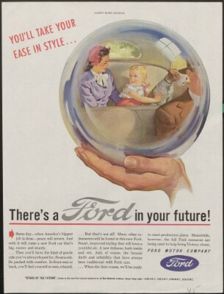
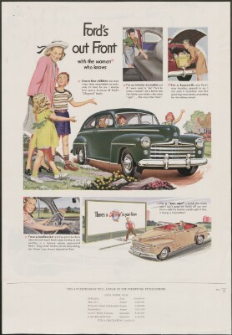
1945
1946
1947

Slide 3
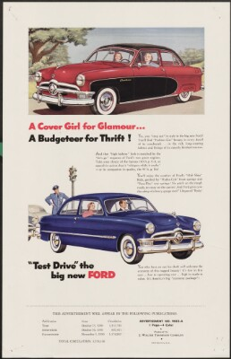
1949
1950
1950

